Slide 1

Model Selection (and Validation)
Rayid Ghani and Kit Rodolfa

Slide 2
Reminders
Project check-in on Wednesday
Temporal Validation “whiteboard” session Thursday
Project Assignment due on Friday

Slide 3
How to solve a prediction problem
Define and Create Rows (unit of prediction)
Define and Create Label (outcome variable)
Define and Create Features (predictors)
Create Training and Validation/Test Sets
Train model(s) on Training Set
Validate model(s) on Validation/Test Set
Select “best” model

Slide 4
What is the goal of model selection?

Slide 5
What is the goal of model selection?
You’ve run a large number of different types of models varying …
You need to understand what types of models are effective under what circumstances, and
You need to decide which one(s) to use in the future

Slide 6
What should the model we select generalize to?

Slide 7
What do we need our selected model to do?
Perform well
What metric?
Compared to what?
Generalize
Over what dimension?

Slide 8
What do need to know to perform model selection
Deployment scenario
Model selection Methodology
Metric(s) (need to match your policy goals)
Comparison with baselines (to know if you’re effective)

Slide 9
How do we select a model that does that?

Slide 10
Model Selection - Methodology
In-sample
Out of sample
Multiple Out-of-sample (Hold-out) Splits
Cross Validation
Leave one out (LOO)
K fold
Temporal Holdouts
Spatial Holdouts
Other Holdouts?

Slide 11
Performance Metrics

Slide 12
Score Distribution on the Test Set
# of people
Score

Slide 13
Evaluation - Metrics
Predictions are often scores between 0 and 1
We need to first turn them into 0 or 1 by selecting a threshold
Predicted Class
 | Yes | No
Yes | True Positives (TP) | False Negatives (FN)
No | False Positives (FP) | True Negatives (TN)
Actual Class

Slide 14
Evaluation – Metrics (at a threshold k)
Accuracy = (TP + TN) / (TP + TN + FP + FN)
Precision (or PPV) = TP / (TP + FP)
Recall (or Sensitivity) = TP / (TP + FN)
Specificity = TNR
Predicted
 | Yes | No
Yes | True Positives (TP) | False Negatives (FN)
No | False Positives (FP) | True Negatives (TN)
Actual

Slide 15
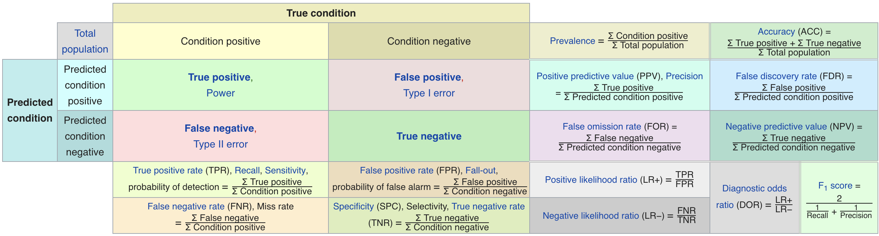
Metric Cheatsheet
Source: https://en.wikipedia.org/wiki/Sensitivity_and_specificity

Slide 16
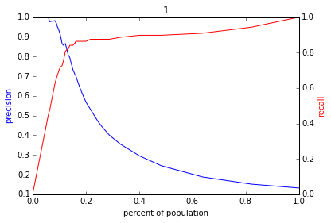
Varying the Threshold
Score
1 .9 .8 .7 .6 .5 .4 .3. .2 .1
| | | | | | | | | |
Baseline

Slide 17
ROC Curve
Receiver Operator Characteristic Curve

Slide 18
AUC (Area Under Curve)
Overall measure of performance
1 if all 1s are ranked above all 0s
0 if all 0s are above all 1s

Slide 19
Evaluation - Baselines
Random (predict most frequent class)
Simple heuristics
Expert heuristics (what may be in use today)

Slide 21
AUC – Area Under Curve
If you care about the entire space

Slide 22
Things to remember

